Slide 1

The Battle of Neighbourhoods
Harsh Shah

Slide 2
1. Problem
In London, there are numerous boroughs. The city is famous for its many touristic spots and is one of the most visited cities on the planet. In addition to tourists, many students come to London in order to study at university. As well as this, many people come for short term stays for e.g. internships, as well as for graduate programs.
Finding a good place to stay is very important, somewhere that has local access to shops and supermarkets, as well as restaurants, bars and a number of other facilities.
HS is moving to London in order to study at University College London. In addition to university life, HS also wants to get a feel of the city's culture, food etc. He's looking to live in a neighbourhood that is culturally vibrant but not too touristy, as he feels that he can visit tourist sites in his spare time, therefore the proximity of tourist attractions is not something that matters to him.
From the perspective of students, many factors are involved when searching for the best accommodation, which includes distance and rent. However, this project will focus on the general atmosphere of different areas of London as well as safety.
The research carried out is expected to be of benefit to international students looking to live in London, because despite the opportunity to explore the local culture, they would very likely want to feel at home at the same time.

Slide 3
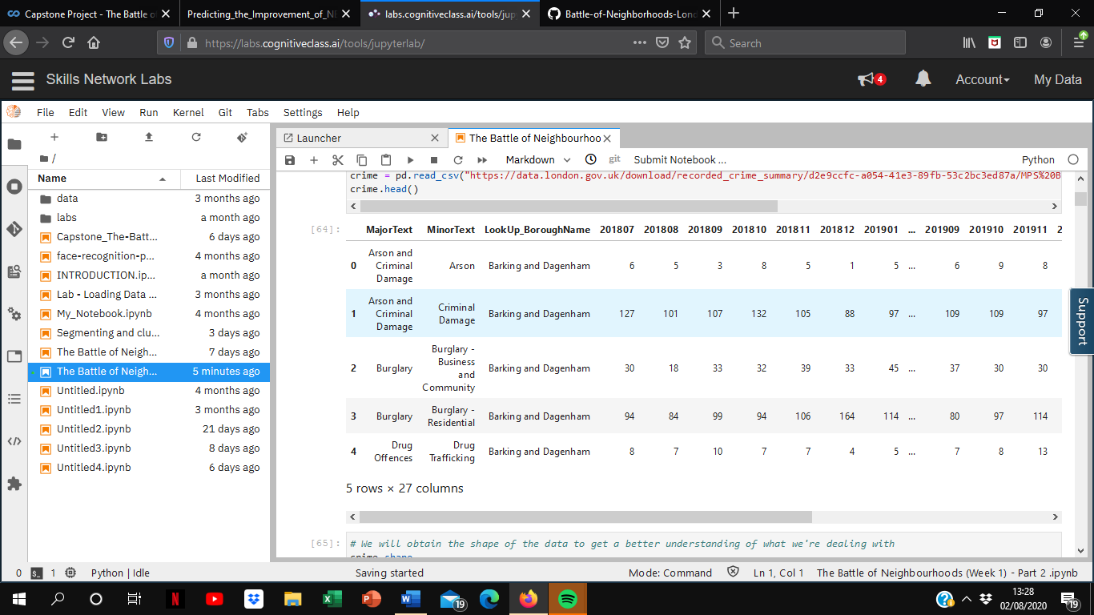
2. Data
In the project, I will be using the following datasets to produce an outcome - Borough Level Crime, List of London boroughs and Foursquare API. After using legitimate resources to acquire them, they will be cleansed into more useful forms so that they can be analysed further.
(1) Borough Level Crime
Description: London crime records classified by borough and crime type over the last 24 months
Size: 1569 observations x 27 columns
Source: London Datastore, https://data.london.gov.uk/dataset/recorded_crime_summary

Slide 4
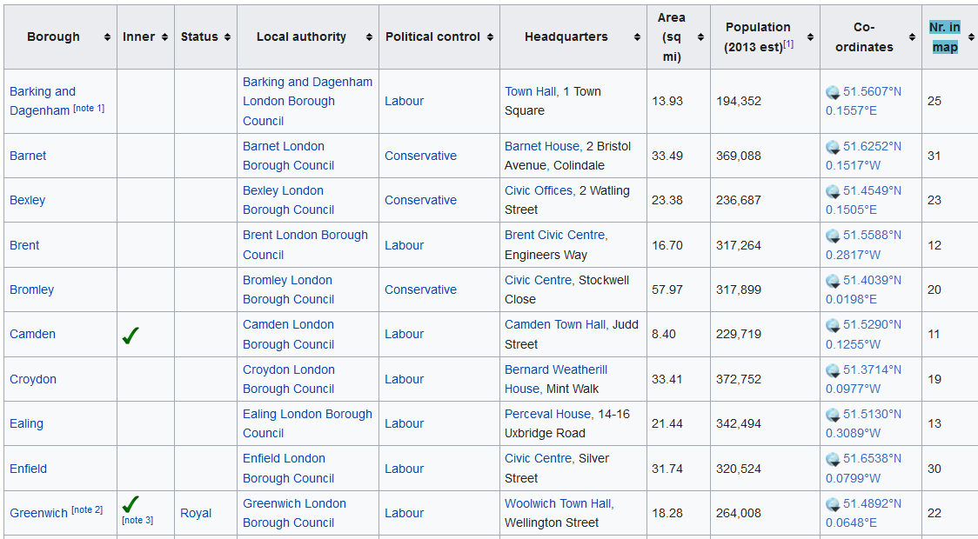
2. Data
(2) List of London Boroughs
Description: Information 32 London boroughs, of which the variables ‘Population’ and ‘Co-ordinates’ will be used for the purpose of the project.
Source: “List of London Boroughs”, Wikipedia
URL: https://en.wikipedia.org/wiki/List_of_London_boroughs

Slide 5
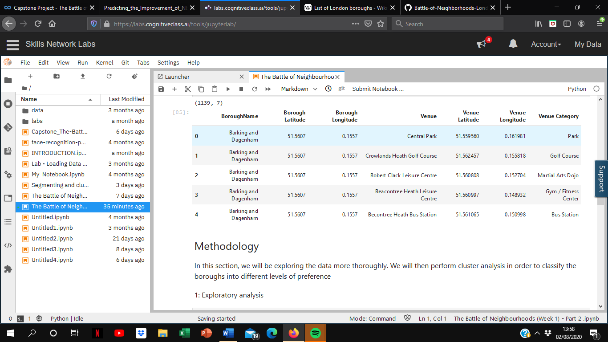
2. Data
(3) Foursquare API
Description: List of the 50 most popular places in each borough. However, it’s possible that some boroughs may have less than 50 registered on Foursquare
Source: Foursquare API
URL: https://api.foursquare.com

Slide 6
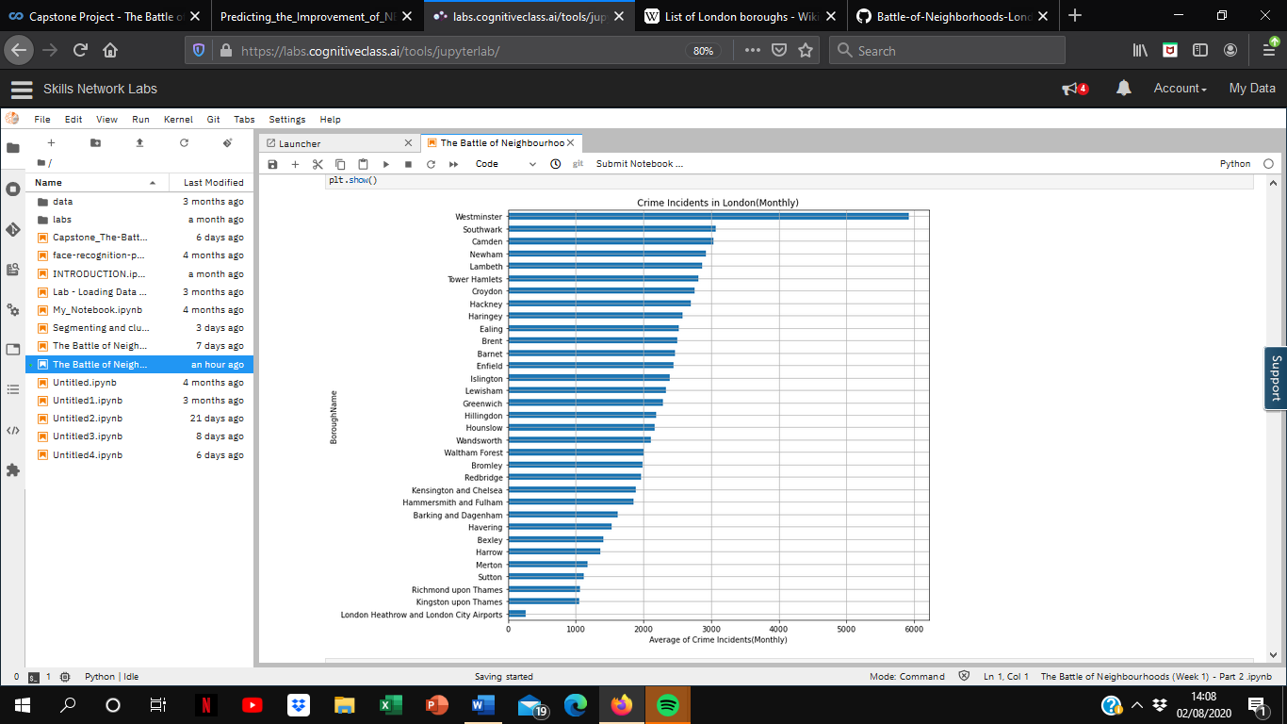
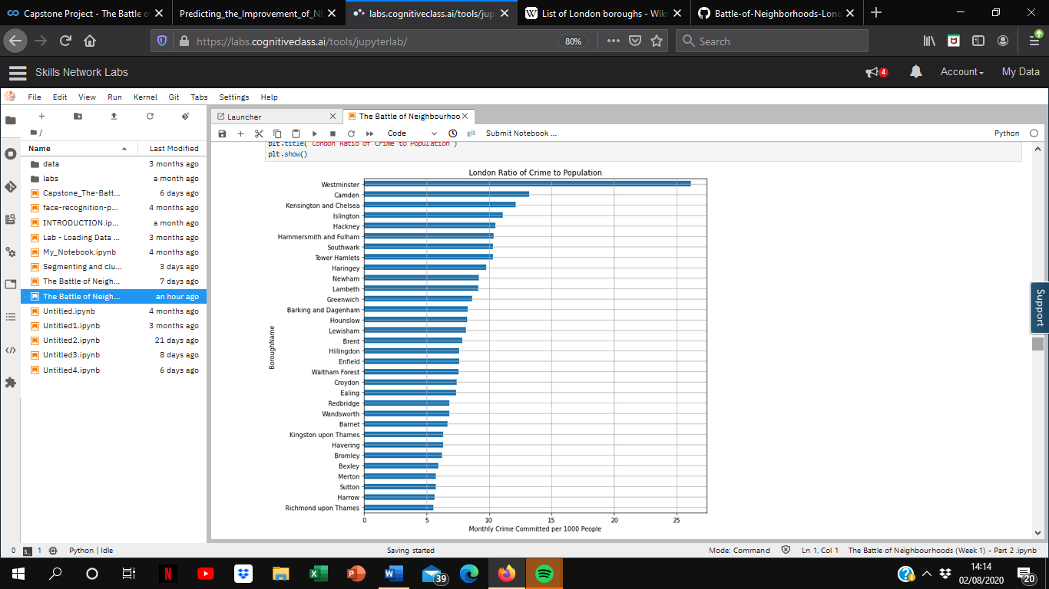
3. Methodology
(1) Exploratory analysis: Which borough has higher levels of crime?
To have a better look at the datasets, they were each cleansed into more useful resources.
By combining the Borough Level Crime data and the List of London Boroughs, the number of crimes per 1000 people was calculated.
While visualising the boroughs according to total level of crimes and by the ratio of crime per 1000 people, it can be seen that both Westminster and Camden still remain 2 of the most dangerous boroughs to live.

Slide 7
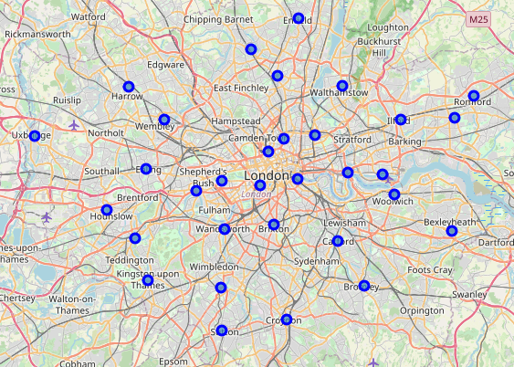
3. Methodology
(2) Exploratory analysis: London Map
Using the coordinates of each of the London boroughs, I was able to visualise each of the boroughs on a map to be able to get more familiar with London’s geography.

Slide 8
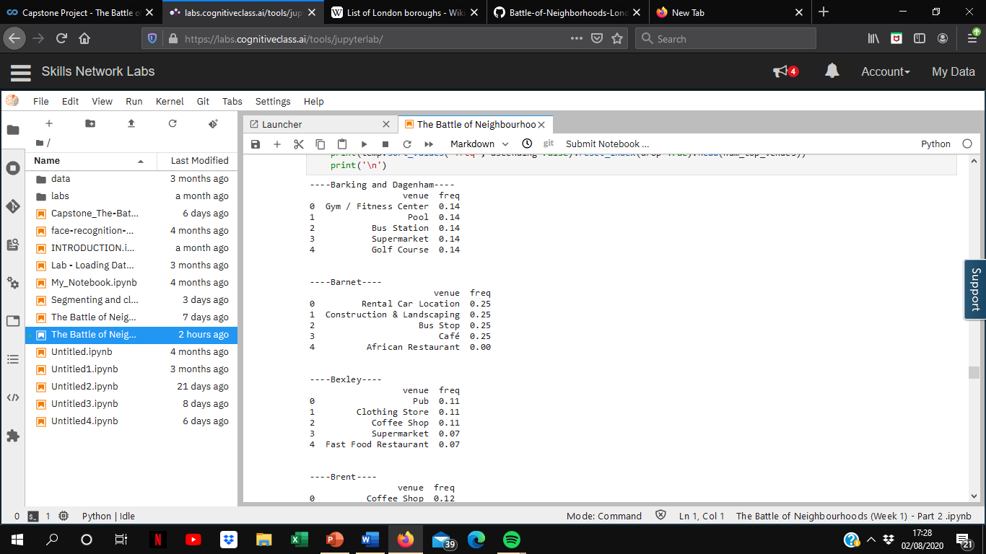
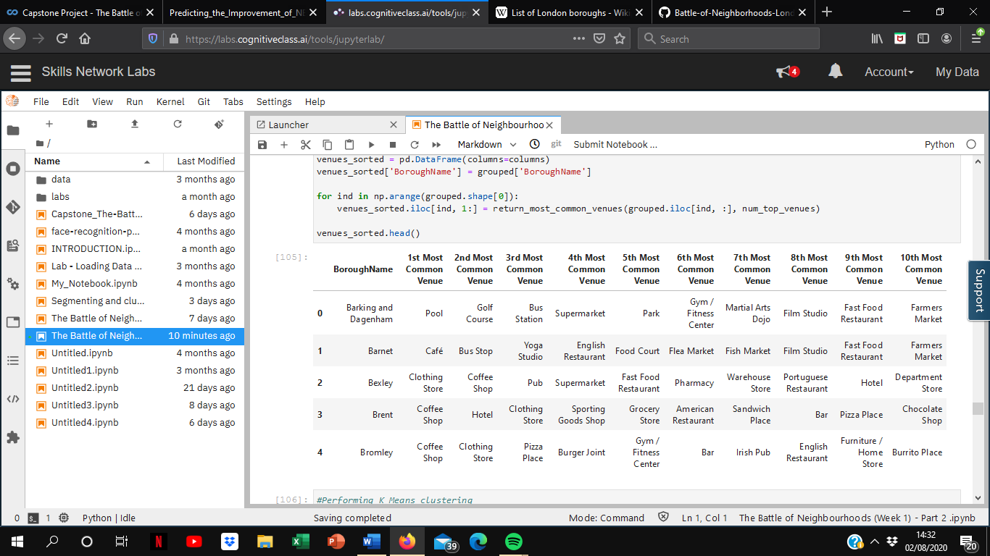
3. Methodology
(3) Cluster analysis
With the 50 most popular venues acquired from Foursquare, I used onehot encoding to find out the most popular venue categories. Venues from the same boroughs were grouped by borough names and the popular categories by frequency.

Slide 9
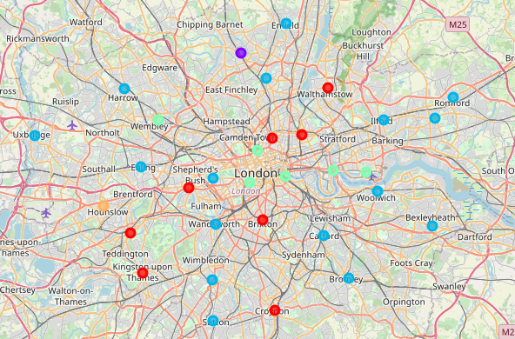
3. Methodology
(4) Cluster analysis: K-means clustering
Based on common venue categories, the boroughs were grouped into 5 different clusters, which are represented on the map by different coloured dots.

Slide 10
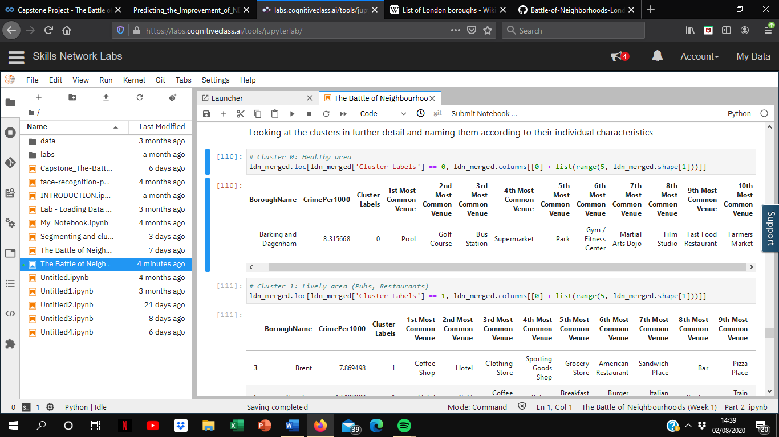
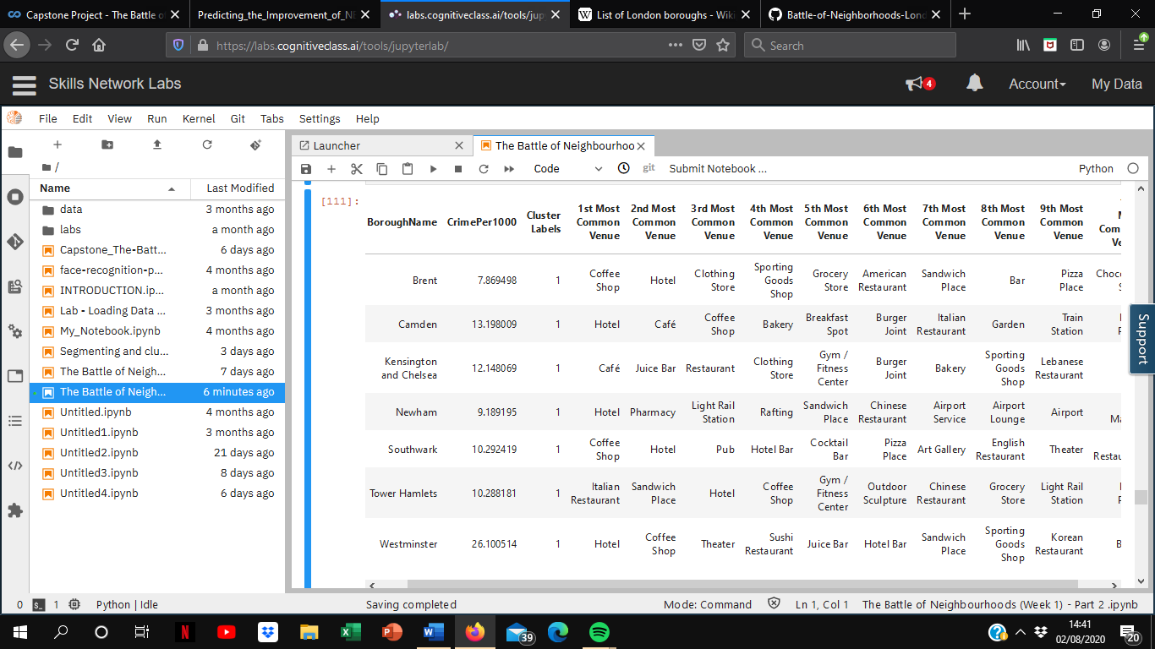
3. Methodology
(4) Cluster analysis: K-means clustering
Each of the clusters were named based on their individual characteristics
Cluster 0: Healthy area (Gym, pool)
Cluster 1: Lively area (Pubs, restaurants)

Slide 11
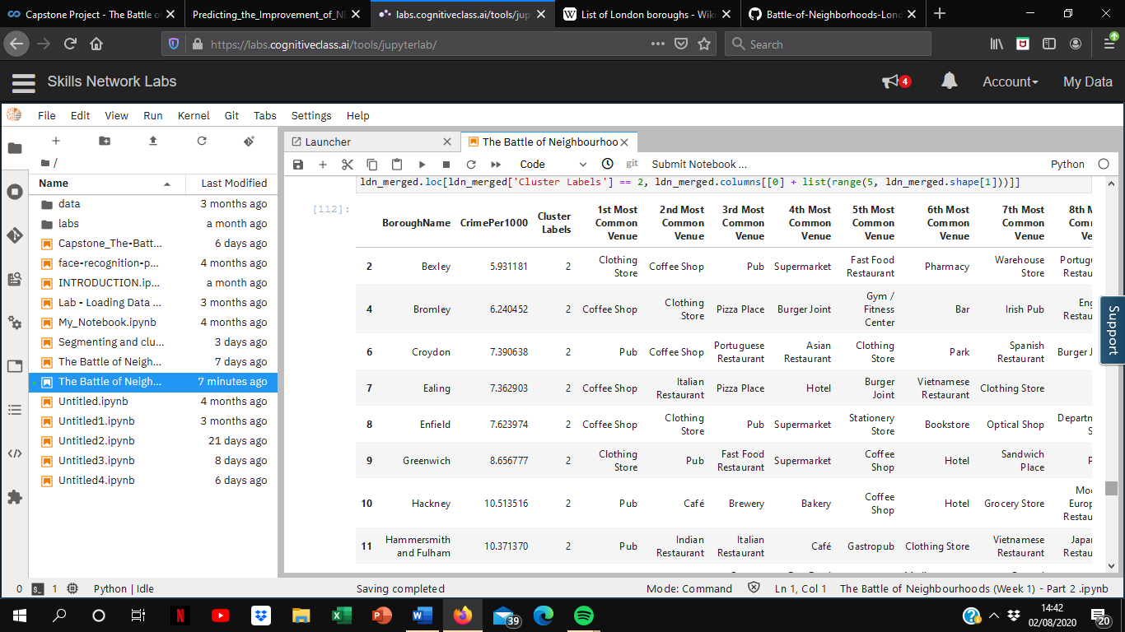
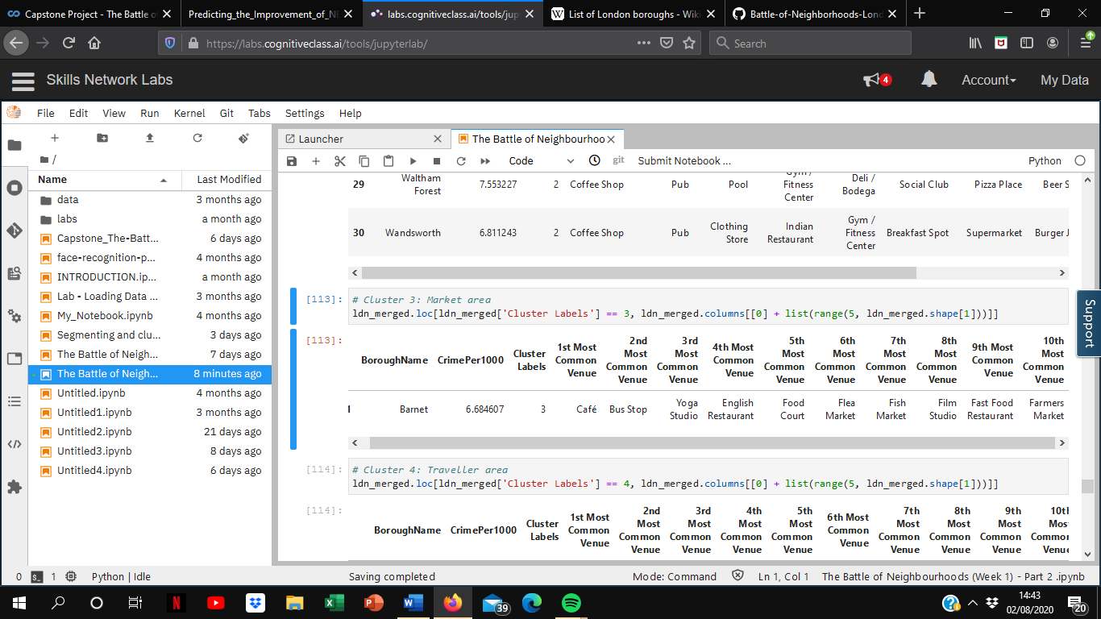
3. Methodology
(4) Cluster analysis: K-means clustering
Each of the clusters were named based on their individual characteristics
Cluster 2: Shopping area (Coffee shops, clothing stores
Cluster 3: Market area

Slide 12
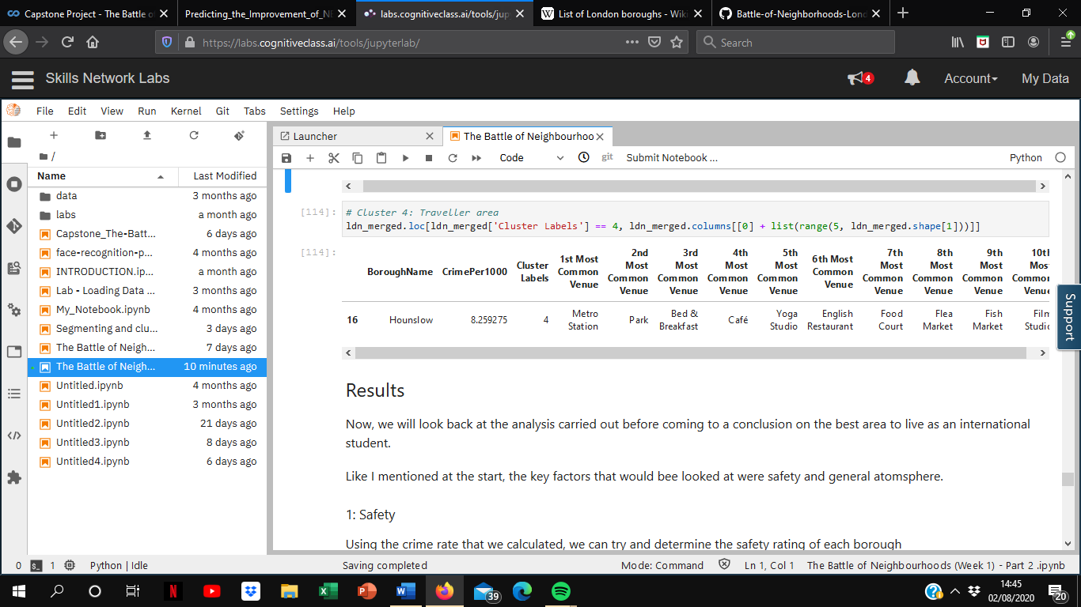
3. Methodology
(4) Cluster analysis: K-means clustering
Each of the clusters were named based on their individual characteristics
Cluster 4: Traveller area

Slide 13
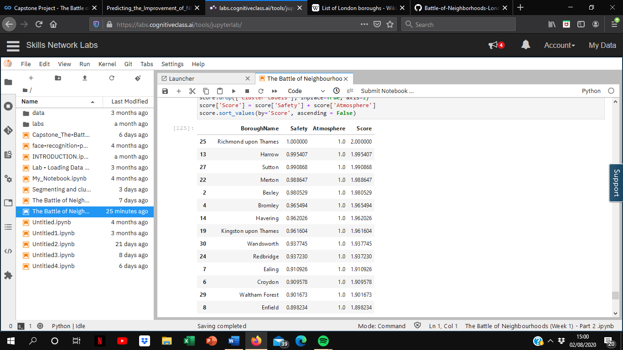
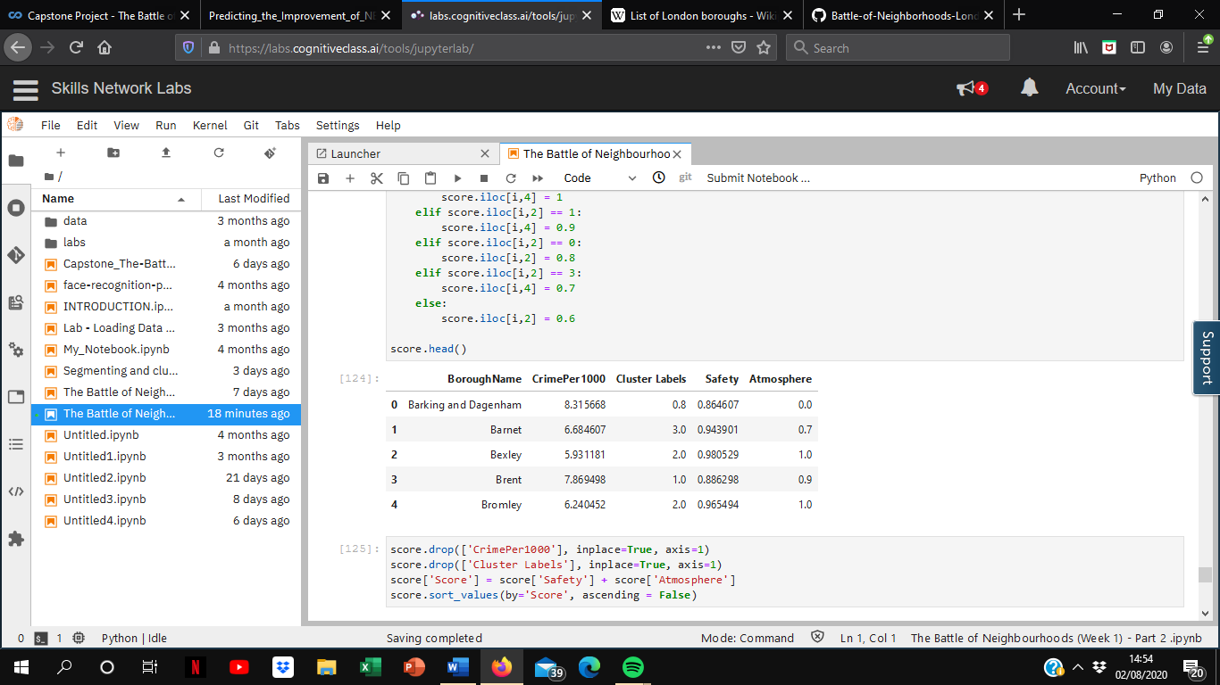
4. Results
Using different analysis, I was able to discover the best areas to live based on the criteria of general atmosphere and safety. Now, we will look back at all the analysis performed in the project before making a conclusion on which area would be the best for HS to live in.
For safety, I decided to normalise the crime to population video and reversed the safety score so that the closes value to 1 represents the area that has the lowest crime per head.
With regards to atmosphere, I decided to give an arbitrary value to each cluster on the basis of personal preference, since preference is difficult to quantify without being subjective. The highest value was given to the Shopping Area (Cluster 2) while the lowest was given to the Traveller Area (Cluster 4).
Finally, by adding the Safety score to the Atmosphere value, I was able to find the best area to live in, which was Richmond upon Thames, scoring 2.0.

Slide 14
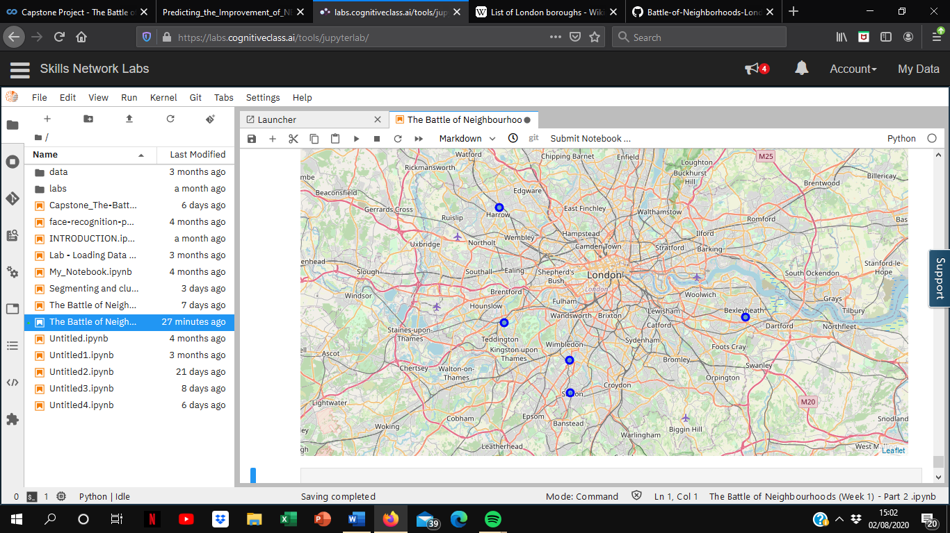
5. Conclusion
Based on the analysis, I have found that the 5 boroughs below would be the best places for HS to live according on the criteria that he set out, based on general atmosphere and safety. They all belong to the Shopping Area cluster, which contains many clothing shops and coffee shops, as well as a number of restaurants that serve a range of cuisines. The only thing that sets them apart is the safety score.
From the map, we can see that all of the top 5 boroughs are located far out from the city, which is due to the limitations held by the research carried out.
As well as taking into account crime rates and the types of stores that exist in each area, I could’ve perhaps also taken into account the number of each type of store that exists in each borough, as well as other factors such as house/rental prices.
Nevertheless, performing this research was still incredible enjoyable as I was able to explore each borough in a lot of depth.

Slide 15
References
“Borough Level Crime”, London Datastore
“List of London Boroughs”
Foursquare API
IBM Data Science Professional Certificate notes, Coursera

